Slide 1
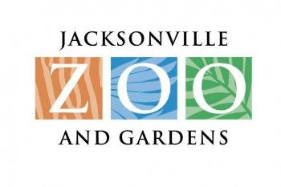
Options for Improved Boater Access to the Jacksonville Zoo & Gardens Presented to the Jacksonville Waterways Commission October 11, 2017

Slide 2
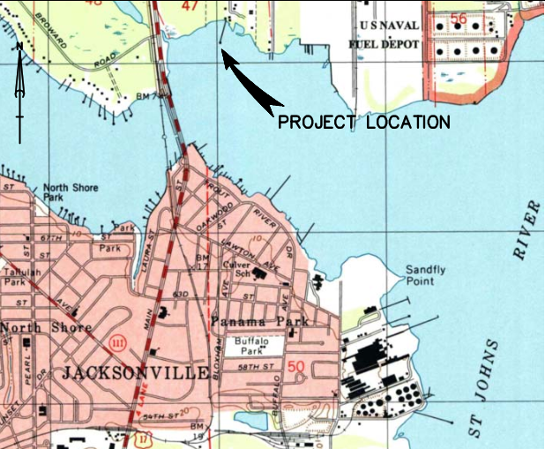
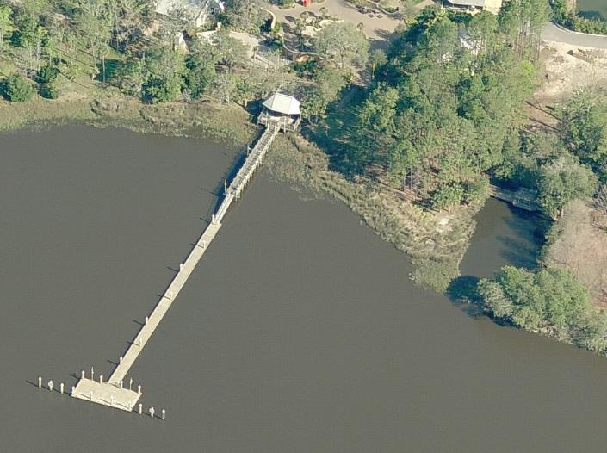
Zoo Dock – General Location
275’ of Floating Dock
115’ of Fixed Dock

Slide 3
Zoo Waterfront Property Map
Duval County Property Appraiser

Slide 4
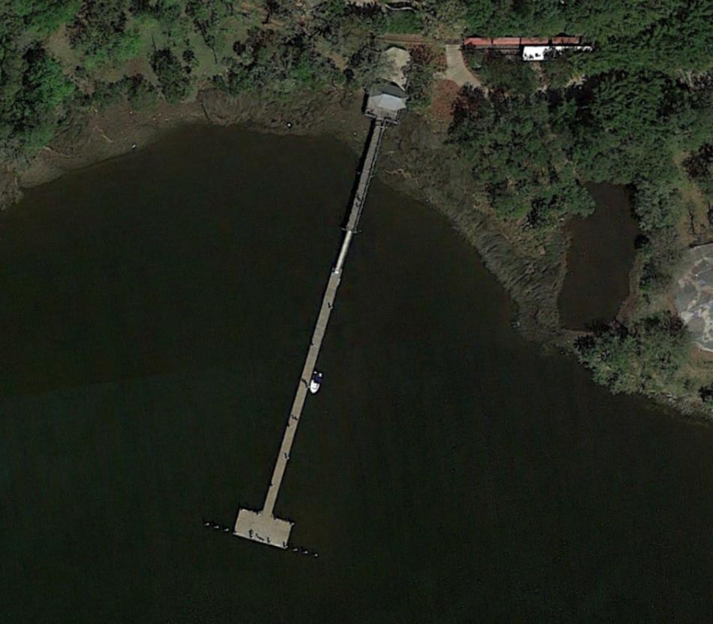
Pre-Hurricane Irma Aerial
Google Earth – 03-15-17

Slide 5
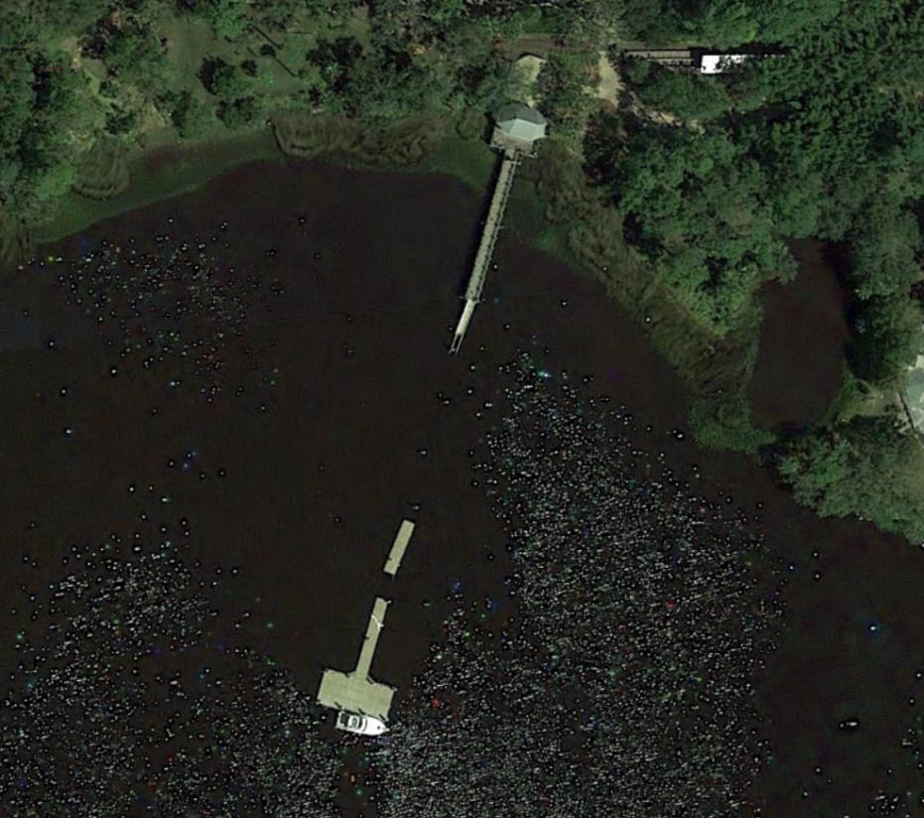
Post-Hurricane Irma Aerial
Google Earth – 09-12-17

Slide 6
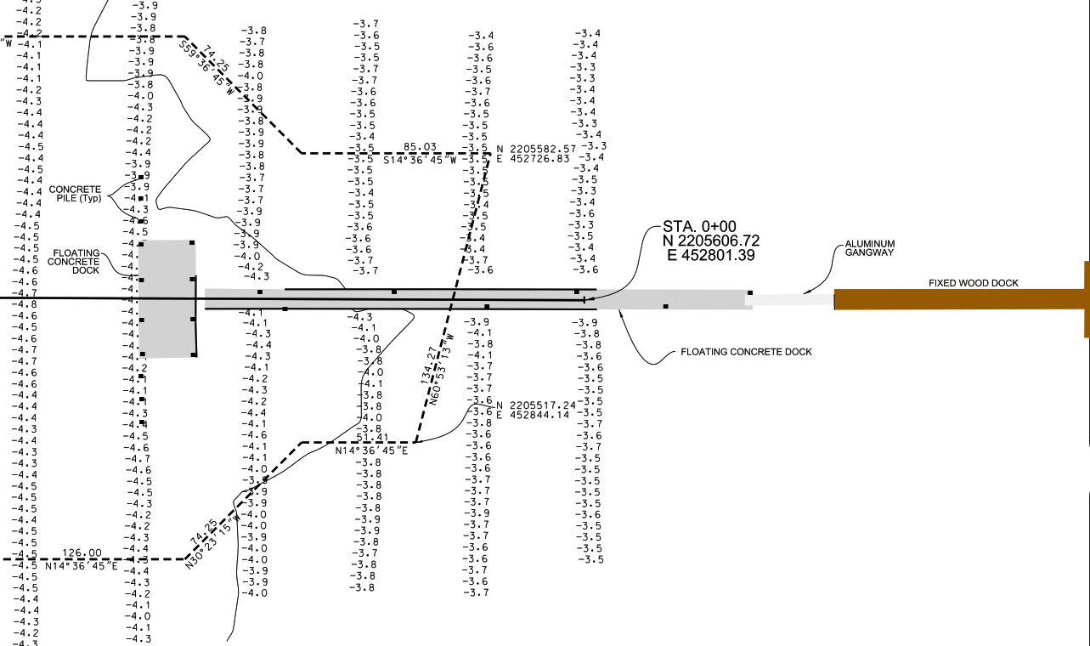
Bathymetry at Zoo Dock
- ARC Surveying & Mapping – 2010
- Depths Relative to NAVD

Slide 7
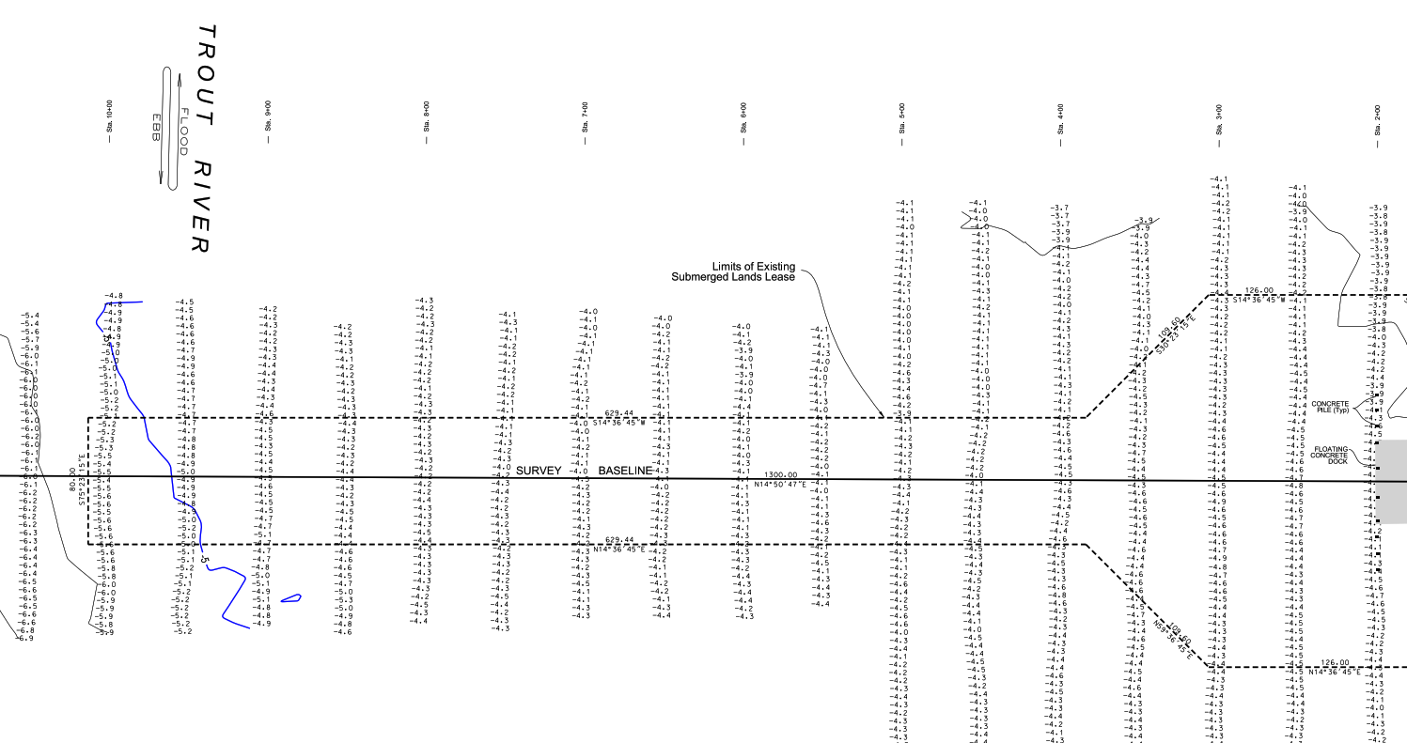
Distance to Navigable Water
-3’ MLLW
Power Boat Size | Rule of Thumb Draft Requirement
20’ | 2.9’
25’ | 3.5’
30’ | 3.9’
Water Taxi | 2.5’
800’ to Navigable Water
-5’ NAVD = ~-3’ MLLW
1,200’ of dredging required for whole dock
- ARC Surveying & Mapping – 2010
- Depths Relative to NAVD

Slide 8
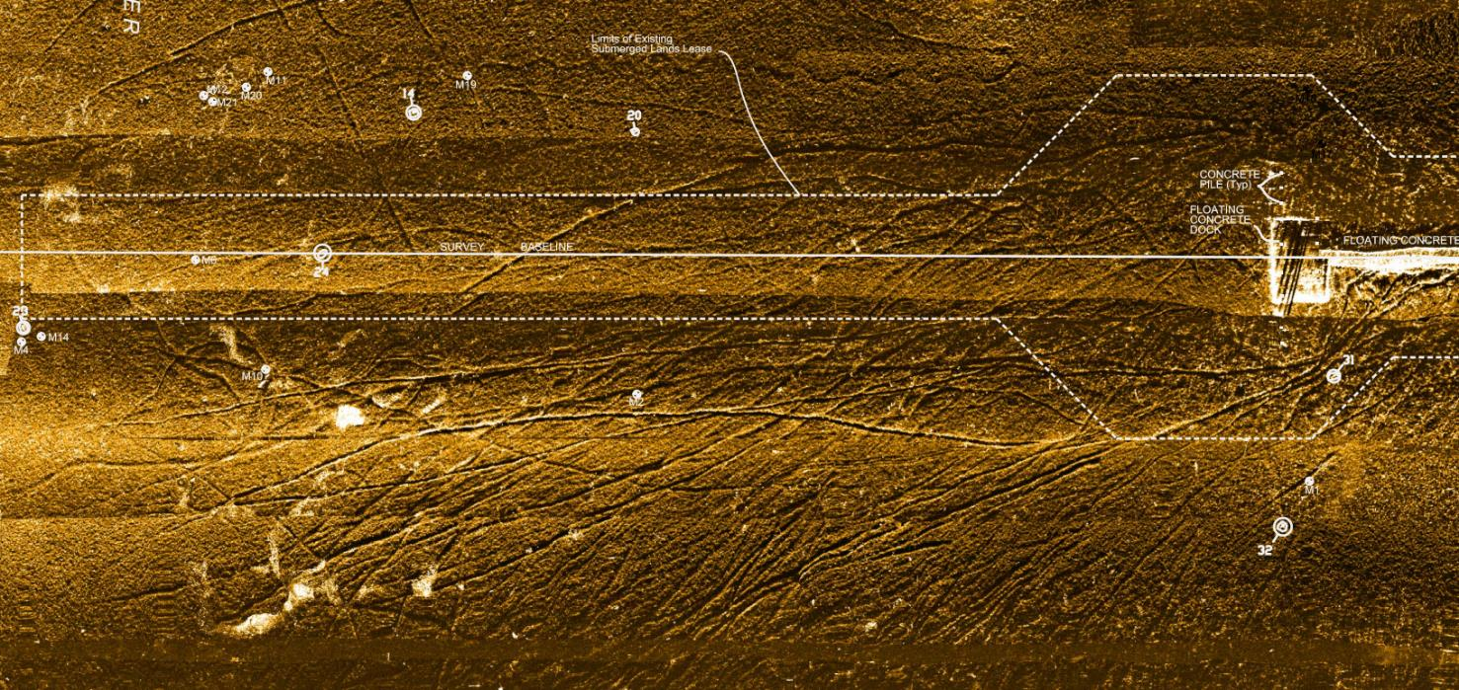
Side-Scan Sonar Mapping
Prop scars verify shallow approach depths
Preferred approach is from off center
Note where prop scars start to disappear
ARC Surveying & Mapping – 2010

Slide 9
Project Goals for Improved Water Access
Focus on Recreational Boaters & Water Taxi
Target Boats Requiring <4’ Draft
Minimize Dredging & Construction Costs
Maximize Project Life
Problems with Currently Proposed Solution
1,000’ of dredging = ~$1,000,000 (Dredge to -6’ MLLW)
No sedimentation modeling to gauge project life
Dredge alignment not optimized to existing conditions
Current floating dock system destroyed by Irma

Slide 10
Options for Improved Access
Dredge currently proposed alignment to -6’ MLLW
~$1,000,000*
Life of project not defined, maybe 4-5 years?
Dredge currently proposed alignment to -4’ MLLW
~$600,000
Larger boats would be excluded
Life of project maybe 3 years?
Dredge Channel Aligned Slightly to the East
~1,000,000
Slightly deeper water but slightly longer dredged channel needed
Life of project probably better due to ebb tide flushing
Extend Existing Dock
Still need dredging, but will reduce channel length
Expensive at ~$10,000 for every 10’ of extension
Relocate Boating Access Elsewhere on Zoo Property…
* All costs provided are rough order of magnitude estimates only

Slide 11
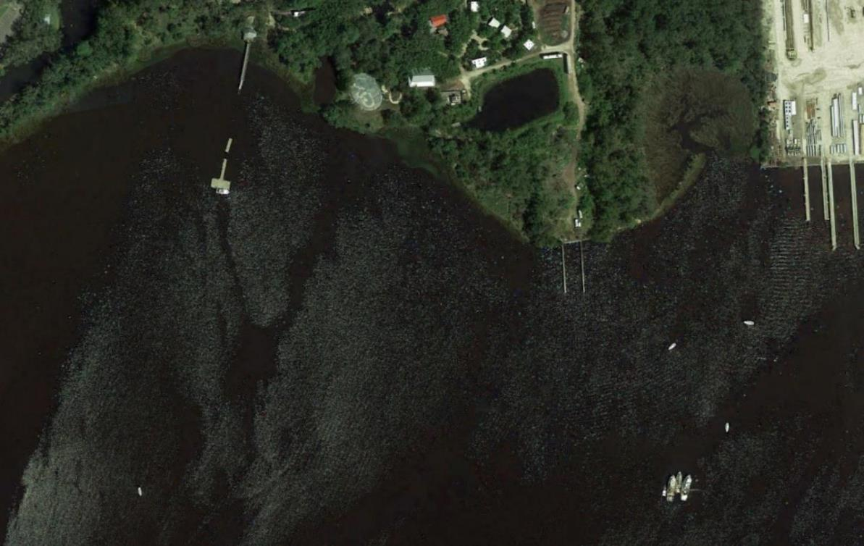
Potential Alternate Boater Access Site
Jacksonville Zoo Gate Dock
Google Earth – 09-12-17

Slide 12
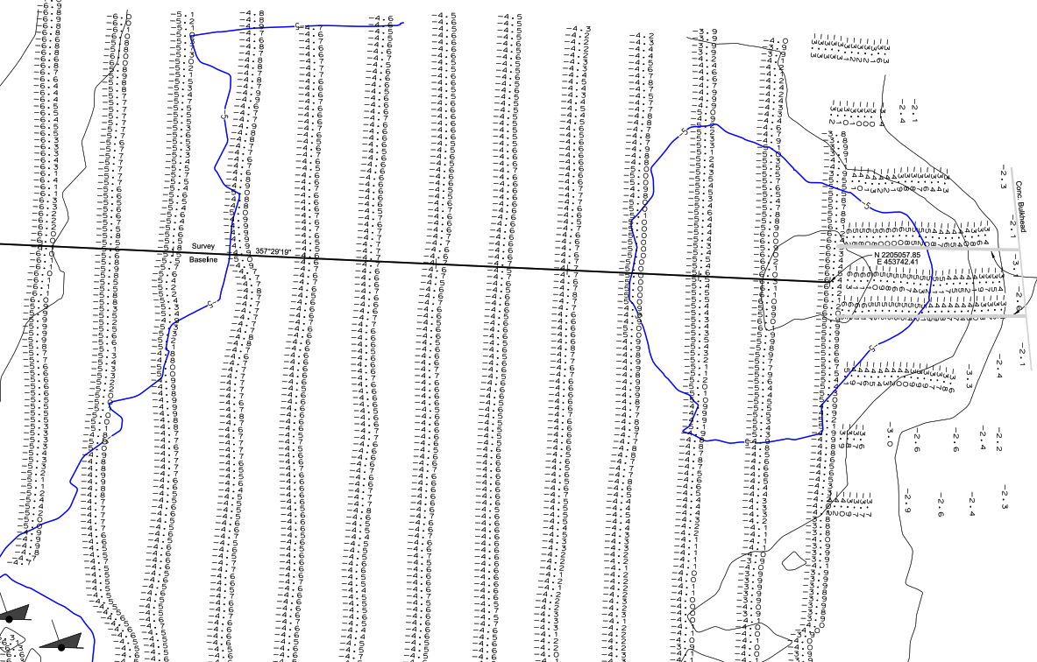
Gate Dock Area Bathymetry
-3’ MLLW
GATE DOCKS
-3’ MLLW
DERELICT VESSELS
ARC Surveying & Mapping – 2010

Slide 13
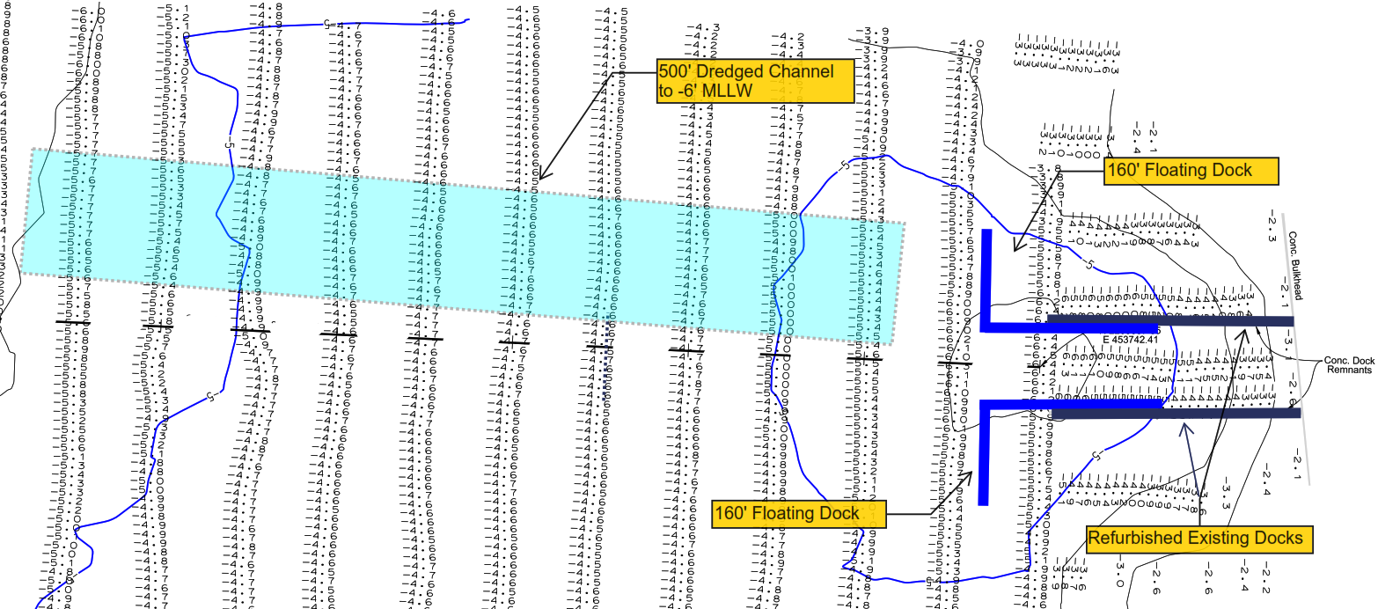
Gate Dock Option 1
Rough Order of Magnitude Cost
Dredging to -6’ MLLW | $500,000
Floating Docks | $350,000
Refurbish Fixed Docks | $200,000

Slide 14
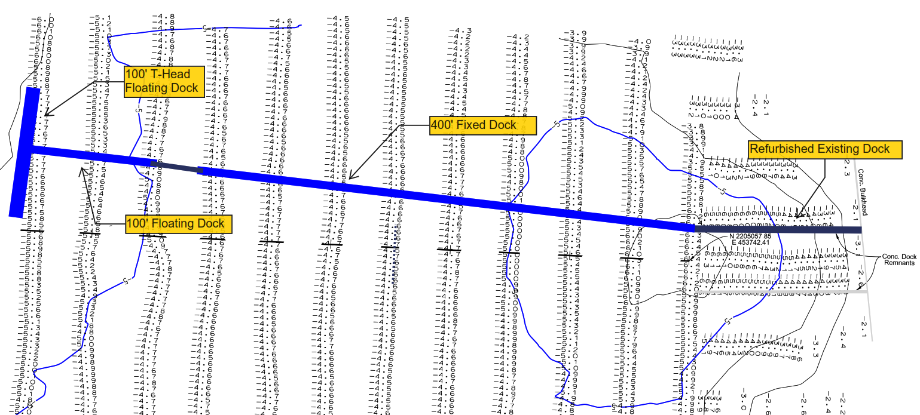
Gate Dock Option 2
Rough Order of Magnitude Cost
200’ Floating Dock | $250,000
400’ Fixed Access Dock | $300,000
Refurbish Fixed Dock | $100,000

Slide 15
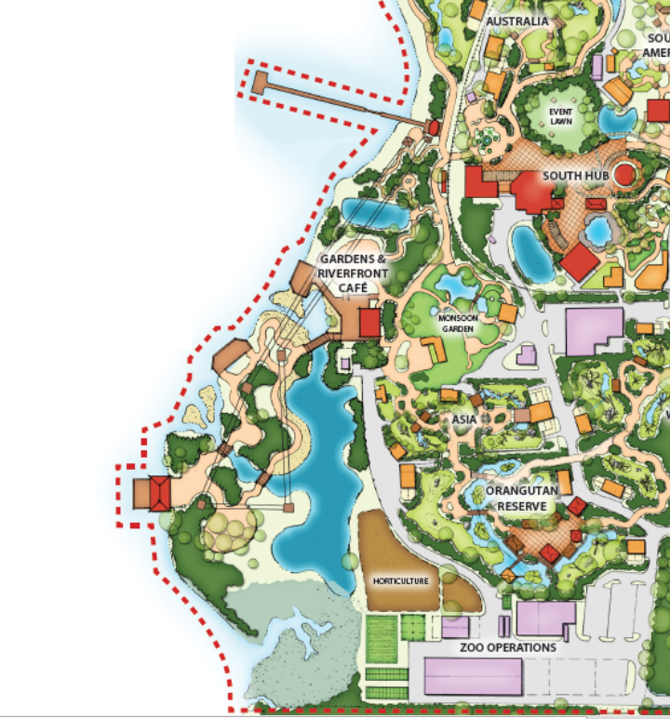
Jacksonville Zoo & Gardens
Illustrative Master Plan Overlay
with Gate Dock Option 2

Slide 16
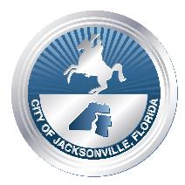
Jacksonville Zoo & Gardens
Recommendations for Boater Access Improvements
Repurpose Existing Fixed Dock & Remove Remnant Floating Docks
Obtain new Bathymetric Survey for Gate Dock Area
Take Advantage of Naturally Deeper at Gate Dock Area
Determine Optimum Combination of Dredging & Docks to:
Maximize Life Expectancy
Minimize Capital Costs
Coordinate Final Design with New Master Plan

